Slide 1
Program Name goes here
Link to github Repository:
Links to trello board / project management tools:
You MUST provide evidence showing how the problem has been decomposed, how the components have been developed and trialled, and of how they have been assembled and tested to create a final, working outcome.

Slide 2
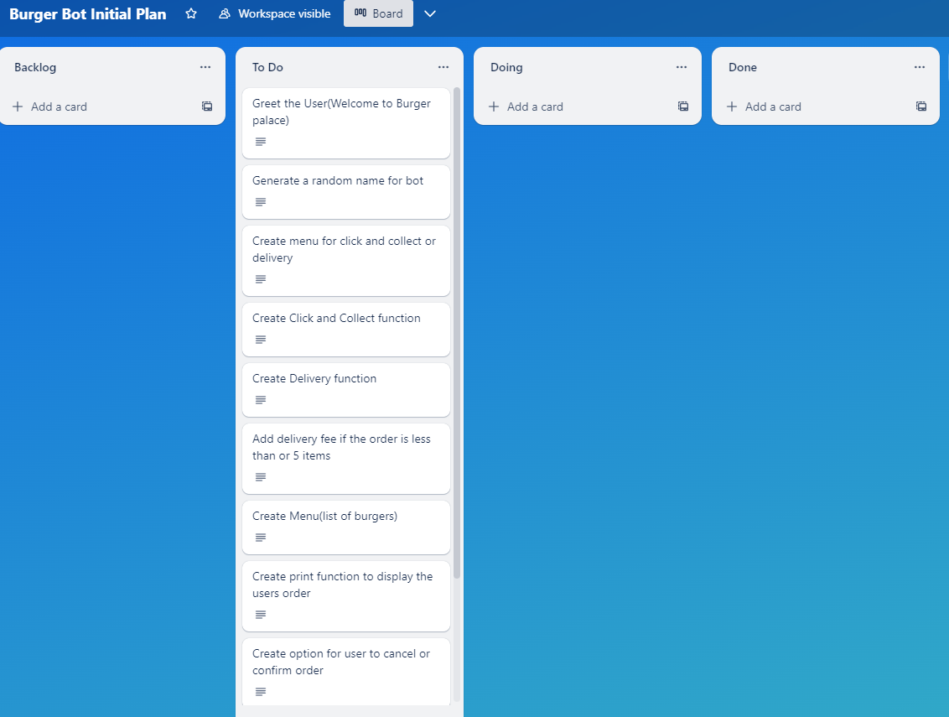
Decomposition 1 (Trello Screen Shot)

Slide 3
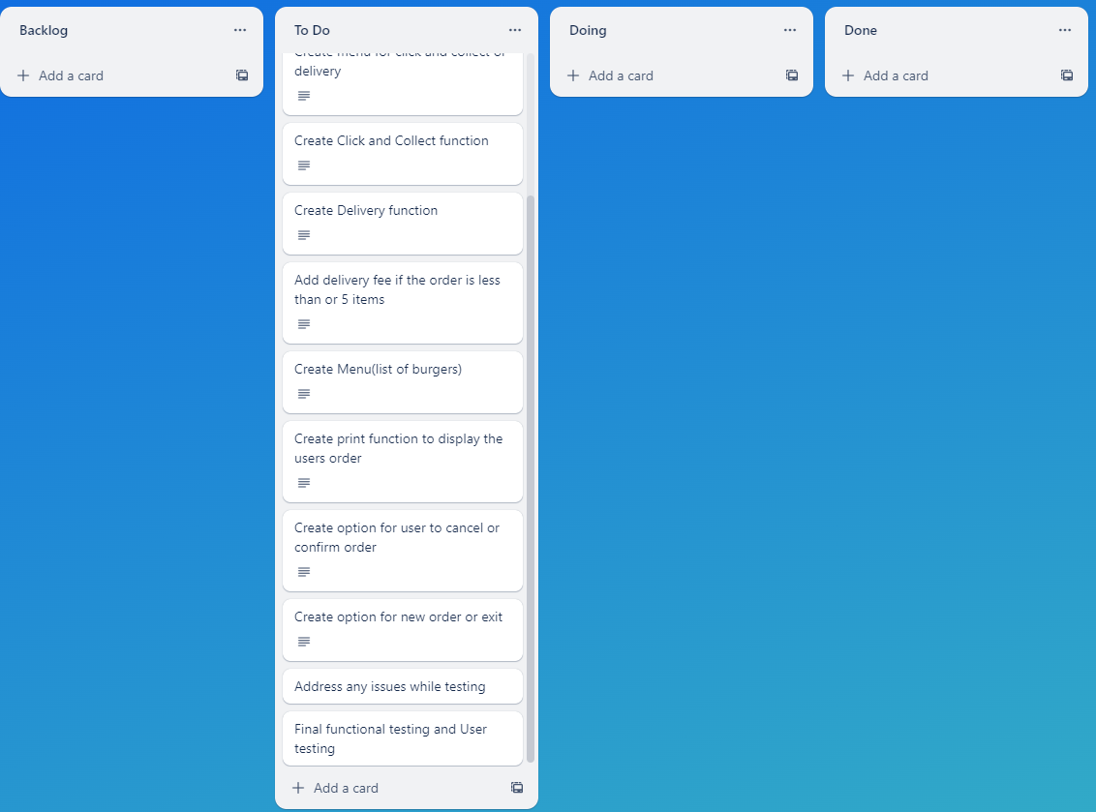
Decomposition 2 (Trello Screen Shot)

Slide 4
Relevant Implications
You must have at least 3. You can have more if you feel you need to consider more.

Slide 5
Explain the relevant implications
Implication 1
Describe the implication
Error recovery when the user has imputed something, and the program sends messages to send any solutions for the problem. So, the BOT must be able to find the problem and find a solution to it too.

Slide 6
Explain the relevant implications
Implication 1
Explain why it needs to be considered
Error recovery is important as the program needs to identify the issue and be able to help the user rather than the user searching through all the information and frustrating them. It is also import because if the program does not use error recovery the user might have to re-do the program and re-enter all the information

Slide 7
Explain the relevant implications
Implication 1
Explain how you plan to address the implication
To ensure the user can recover from errors I will be using value error code and the validation code to inform the user as soon as an incorrect or in-valid code has been entered

Slide 8
Explain the relevant implications
Implication 2
Describe the implication
The second implication is privacy. This implication addresses where someonw can leak ou information

Slide 9
Explain the relevant implications
Implication 2
Explain why it needs to be considered

Slide 10
Explain the relevant implications
Implication 2
Explain how you plan to address the implication

Slide 11
Explain the relevant implications
Implication 3
Describe the implication

Slide 12
Explain the relevant implications
Implication 3
Explain why it needs to be considered

Slide 13
Explain the relevant implications
Implication 3
Explain how you plan to address the implication

Slide 14
Decomposition
Paste screenshots of your initial Trello board / task decomposition on this slide. If you have a long list, you might need to break it up into several columns. Delete this instruction when you are done.
Notes:
Paste screenshots of your initial Trello board / task decomposition on this slide. If you have a long list, you might need to break it up into several columns. Delete this instruction when you are done.

Slide 15
Component Section
Duplicate Slides so that you have TRELLO and a TEST for each component

Slide 16
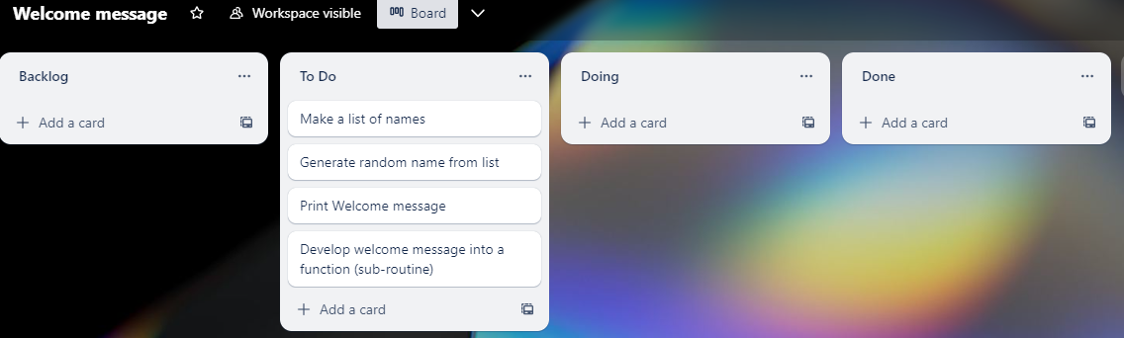
Component 1 (Trello screenshot)
Version 1

Slide 17
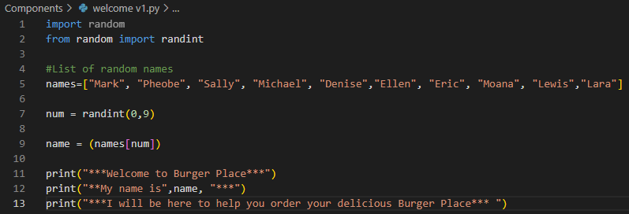
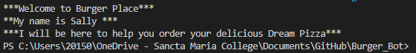
Component 1 – Welcome v1Test Plan (and screenshot)
Test Case | Expected Values
Run program to test | Print Welcome message with random names from list of names – Runs correctly

Slide 18
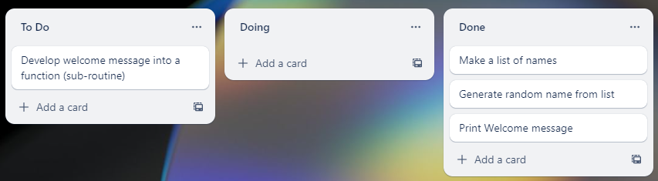
Component 1 v2 (Trello screenshot)

Slide 19
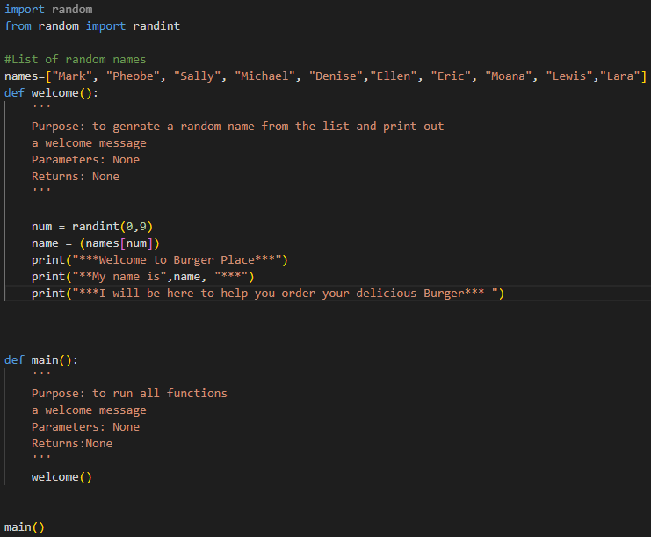
Component 1 – Welcome v2 Test Plan (and screenshot)
Test Case | Expected Values
Run program to test | Main and welcome run correctly. Welcome message prints with random name

Slide 20
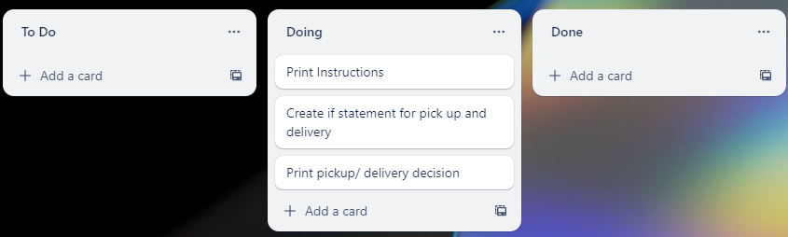
Component 2 Delivery/ click and collect Menu (Trello screenshot)

Slide 21
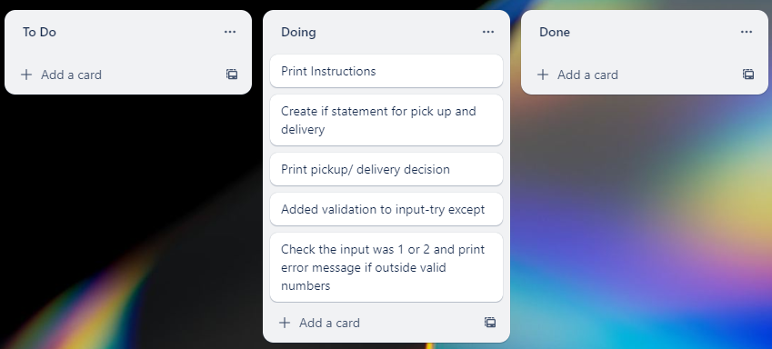
Component 2 Delivery/ click and collect Menu v2

Slide 22
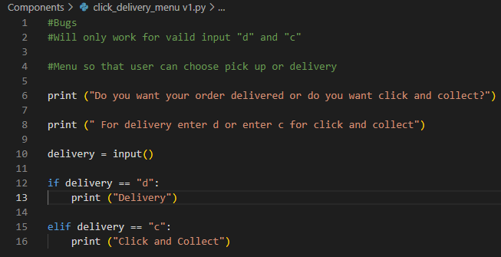
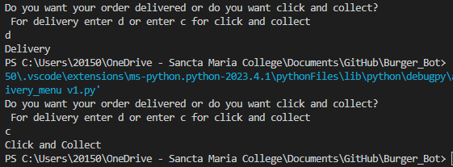
Component 2 Delivery/ click and collect Menu - Test Plan v1(?and screenshot)
Test Case | Expected Values
Run Program | If c is entered program prints click and collect If d is entered program prints delivery​

Slide 23
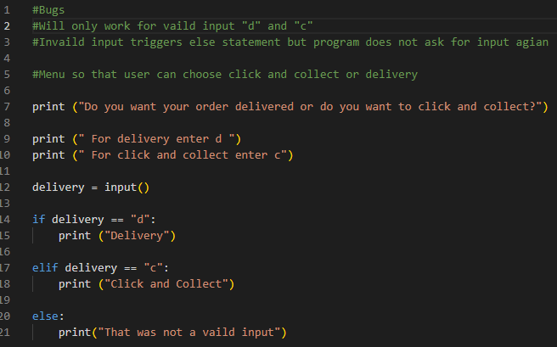
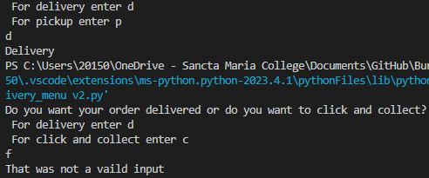
Component 2 - Test Plan v2(?and screenshot)
Test Case | Expected Values
Run Program | Enter c program prints click and collect Enter d program prints delivery​ Enter invalid program prints error message

Slide 24
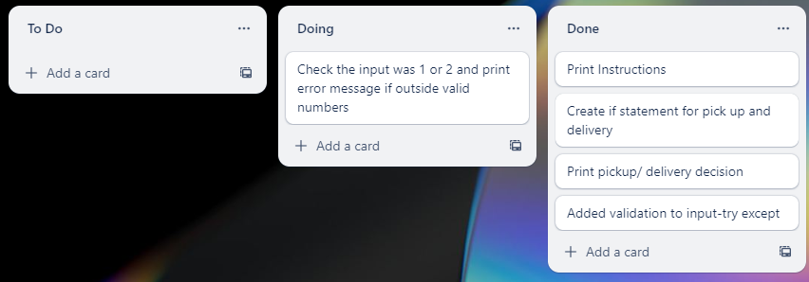
Component 2 Delivery/ click and collect Menu v3 Trello

Slide 25
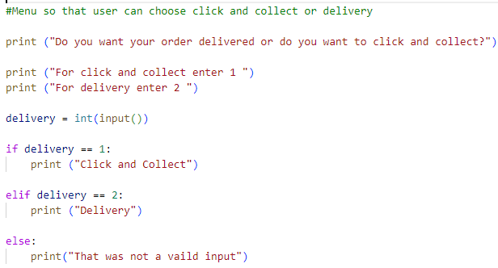
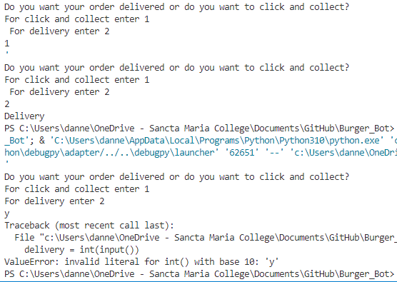
Component 2 - Test Plan v3(?and screenshot)
Test Case | Expected Values
Run Program | Enter 1 program prints click and collect Enter 2 program prints delivery​ Enter invalid, program prints value message

Slide 26
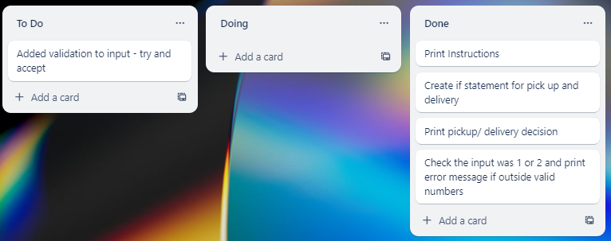
Component 2 Delivery/ click and collect Menu v4 (Trello Screenshot)

Slide 27
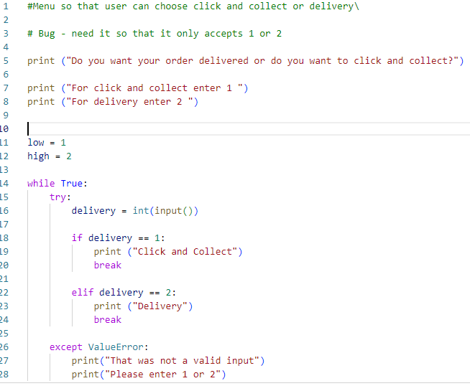
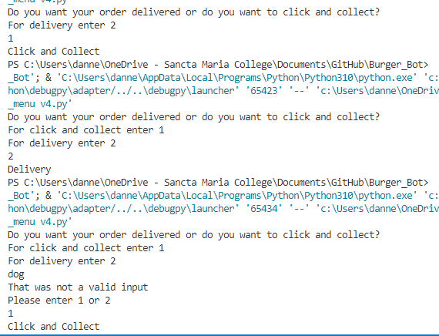
Component 2 - Test Plan v4(?and screenshot)
Test Case | Expected Values
Run Program | Enter 1 program prints click and collect Enter 2 program prints delivery​ Enter invalid, program prints value error and asks for input agian

Slide 28
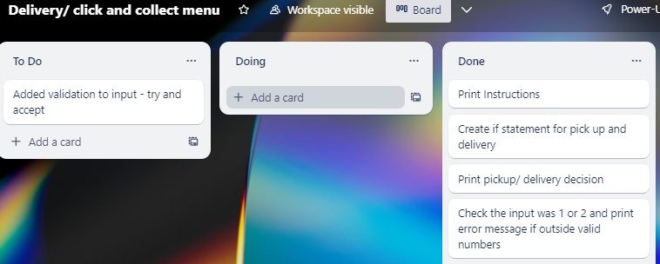
Component 2 Delivery/ click and collect Menu v4 (Trello Screenshot)

Slide 29
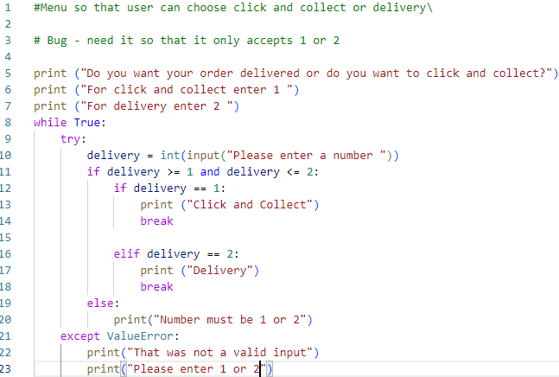
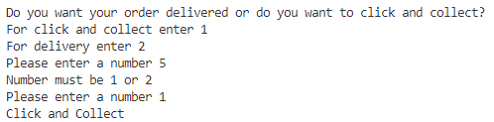
Component 2 - Test Plan v4(?and screenshot)
Test Case | Expected Values
Run Program | Enter 1 program prints click and collect Enter 2 program prints delivery​ Enter an invalid entry, the program asks for input again Enter a number other than 1 or 2, error message asks for entry again

Slide 30
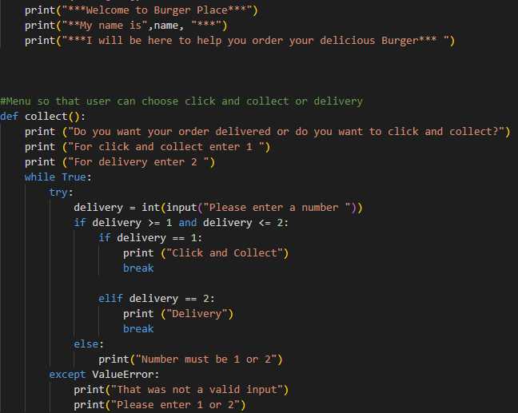
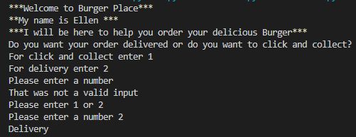
Component 2 - Test Plan Intergration into Main(?and screenshot)
Test Case | Expected Values
Run Program | Enter 1 program prints click and collect Enter 2 program prints delivery​ Enter an invalid entry, the program asks for input again Enter a number other than 1 or 2, error message asks for entry again Printed everything as expected

Slide 31
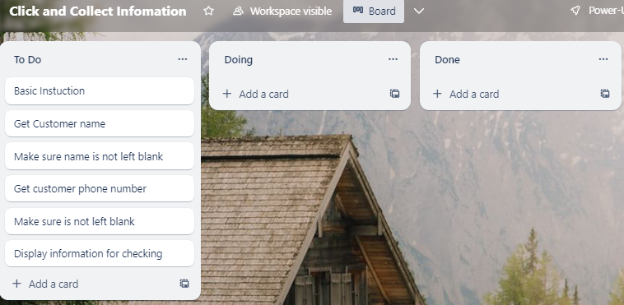
Component 3 Click and Collect Information v1 (Trello screenshot)

Slide 32
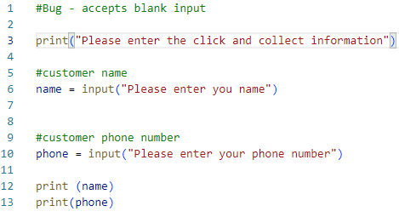
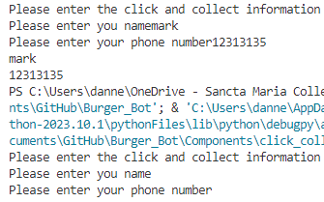
Component 3 version1 - Test Plan (?and screenshot)
Test Case | Expected Values
Input name Input phone number Left input blank | Printed name correctly Printed phone number Accepted blank and printed blank input

Slide 33
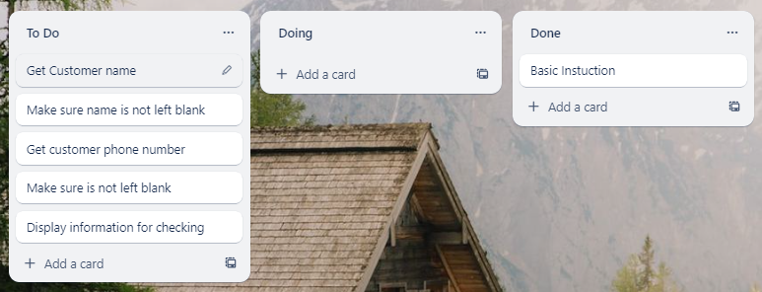
Component 3 Click and Collect info v2(Trello screenshot)

Slide 34
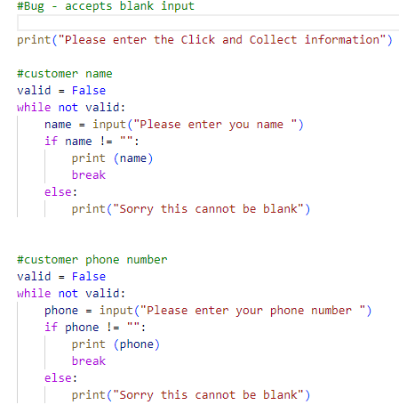
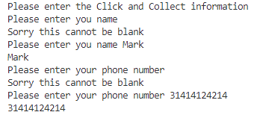
Component 3 version 2 - Test Plan (?and screenshot)
Test Case | Expected Values
Input name Input phone number Left Input blank | Printed name correctly Printed phone number Prints “Sorry this cannot be blank”- goes back to input

Slide 35
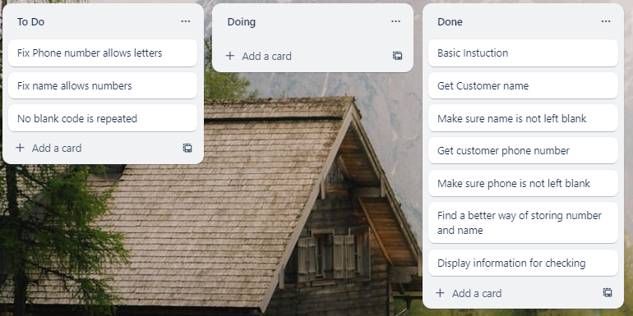
Component 3 Click and Collect info v3(Trello screenshot)

Slide 36
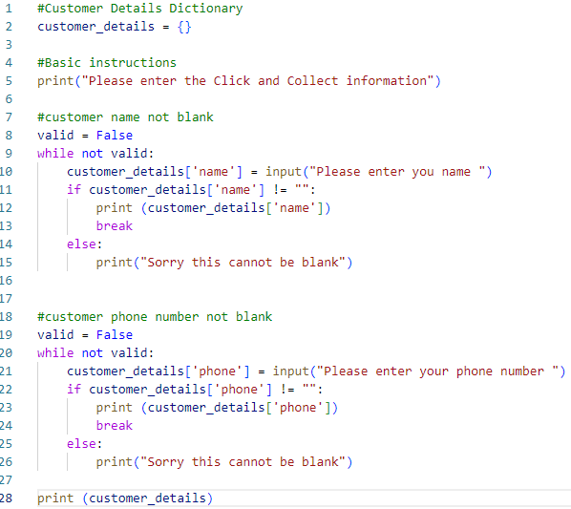
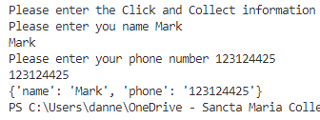
Component 3 version 3 - Test Plan (?and screenshot)
Test Case | Expected Values
Input name Input phone number Left Input blank | Printed name correctly Printed phone number Prints “Sorry this cannot be blank”- goes back to input

Slide 37
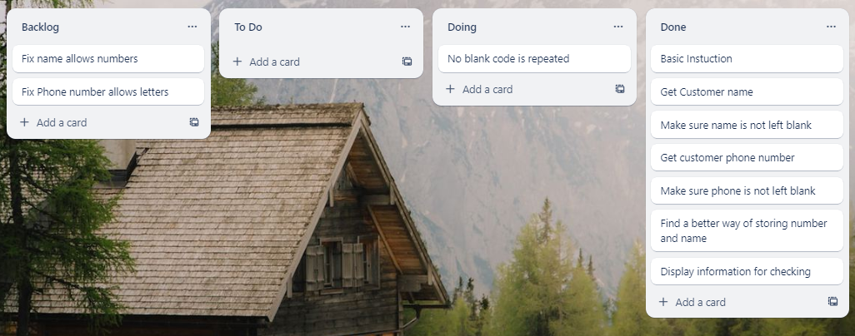
Component 3 Click and Collect info v4(Trello screenshot)

Slide 38
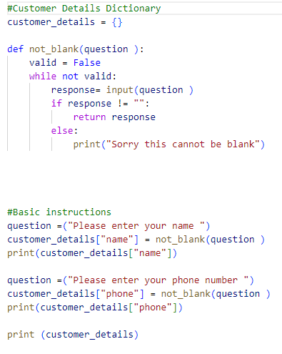
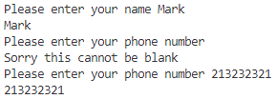
Component 3 version 4 - Test Plan (?and screenshot)
Test Case | Expected Values
Input name Input phone number Left Input blank | Printed name correctly Printed phone number Prints “Sorry this cannot be blank”- goes back to input

Slide 39
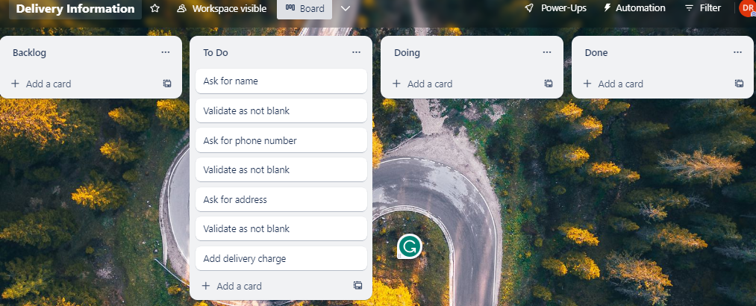
Component 4 Delivery Information v1 (Trello screenshot)

Slide 40
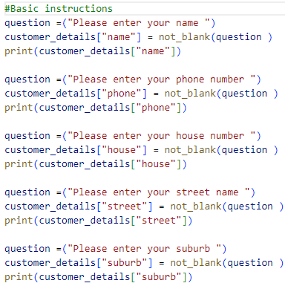
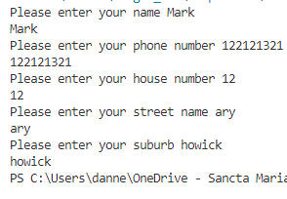
Component 4 - Test Plan (?and screenshot)
Test Case | Expected Values
Input name Input phone number Input house number Input street name Input suburb Left Input blank | Printed name correctly Printed phone number Prints house number Printed street name Printed suburb name Prints “Sorry this cannot be blank” – goes back to input

Slide 41
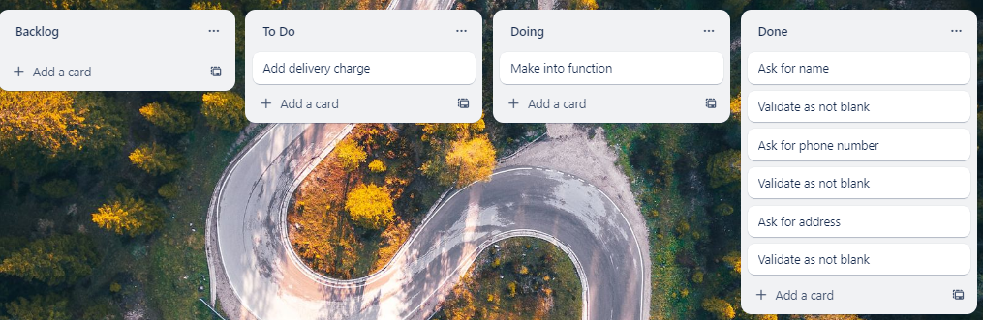
Component 4 Delivery Information v2 (Trello screenshot)

Slide 42
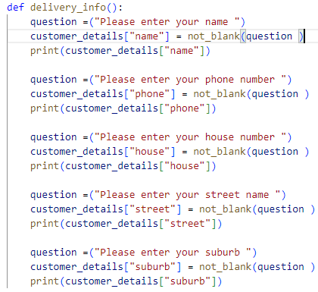
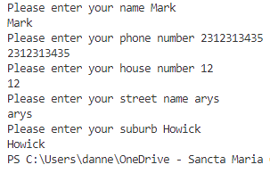
Component 4 version 2 - Test Plan (?and screenshot)
Test Case: Test after making into function | Expected Values
Input name Input phone number Input house number Input street name Input suburb Left Input blank | Printed name correctly Printed phone number Prints house number Printed street name Printed suburb name Prints “Sorry this cannot be blank” – goes back to input

Slide 43
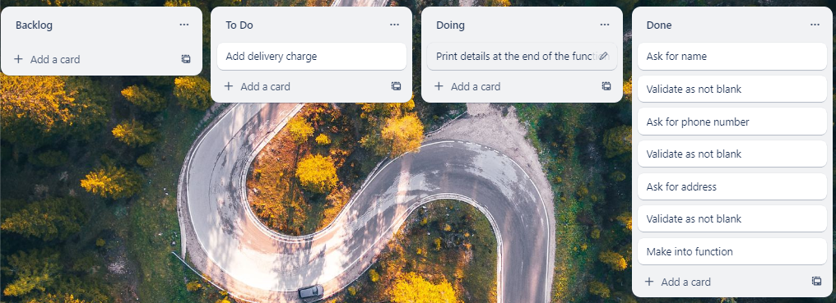
Component 4 Delivery Information v3 (Trello screenshot)

Slide 44
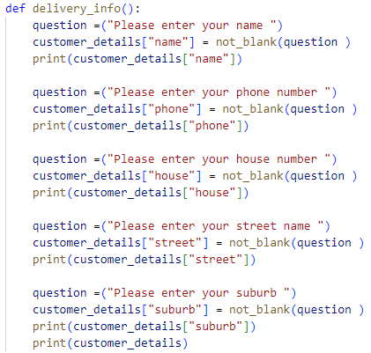
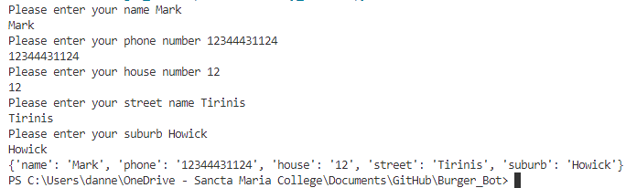
Component 4 version 3 - Test Plan (?and screenshot)
Test Case: Test after making into function | Expected Values
Input name Input phone number Input house number Input street name Input suburb Left Input blank | Printed name correctly Printed phone number Prints house number Printed street name Printed suburb name Prints “Sorry this cannot be blank” – goes back to input

Slide 45
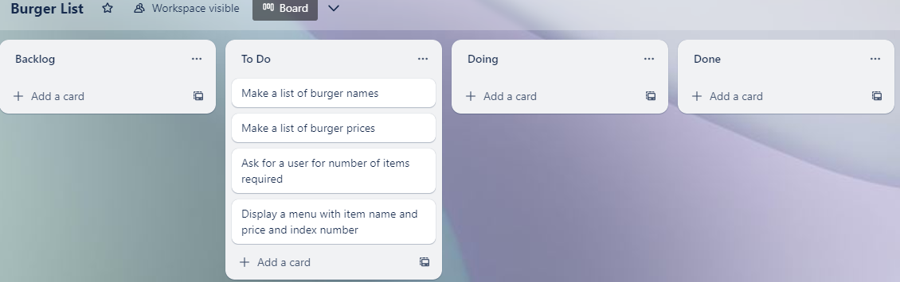
Component 5 Burger List v1 (Trello screenshot)

Slide 46
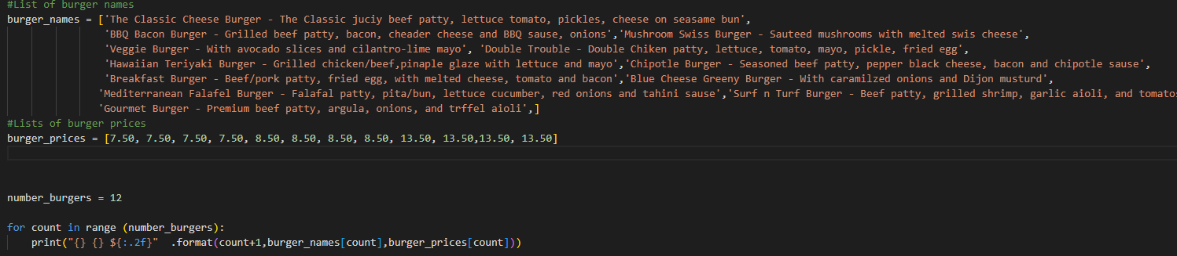
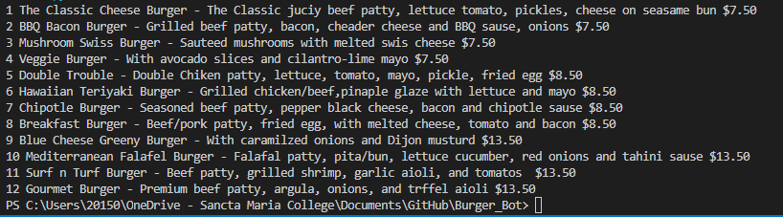
Component 5 Burger List v1 - Test Plan ( screenshot)
Test Case | Expected Values
Run file | Printed a list with index number, pizzas and prices

Slide 47
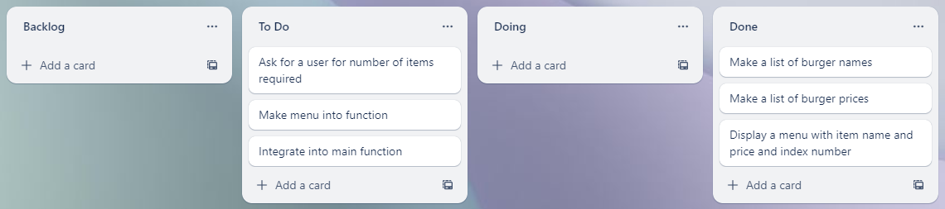
Component 5 Burger List v2 (Trello screenshot)

Slide 48
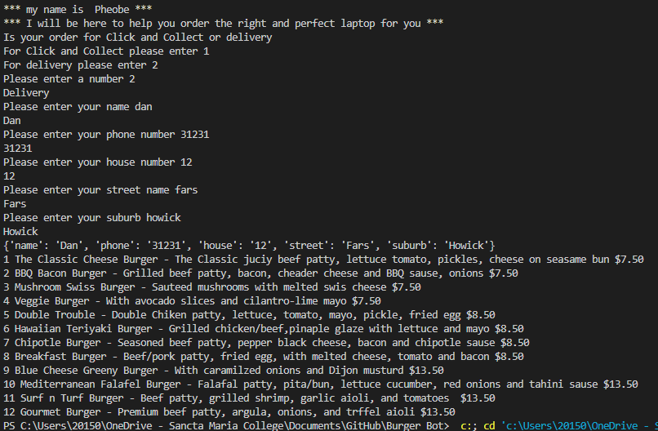

Component 5 Burger List v2 Intergration - Test Plan ( screenshot)
Test Case | Expected Values
Run file | Printed a list with index number, pizzas and prices with price formatted to 2 decimal places and dollar sign. Menu starts at 1

Slide 49

Component 6 – Ordering from burger list v1 (Trello screenshot)

Slide 50


Component 6 – Ordering from burger list v1 - Test Plan ( screenshot)
Test Case | Expected Values
Entered 5 burgers Typing bat Chose number 1 cheese burger | Stepped through the list the amount that I entered Program broke Printed BBQ burger instead

Slide 51

Component 6 – Ordering from burger list v2 (Trello screenshot)

Slide 52


Component 6 – Ordering from burger list v2 - Test Plan ( screenshot)
Test Case | Expected Values
Entered number of laptops I wished for Shows the information for entered index number | Stepped through the list the amount that I entered Printed information as I typed in each number

Slide 53

Component 6 – Ordering from burger list v3 (Trello screenshot)

Slide 54


Component 6 - Test Plan Ordering from burger list v3 (?and screenshot)
Test Case | Expected Values
Entered w Entered special character % Entered 15 Entered number 1 | Printed This is not a valid number Printed This is not a valid number Printed Your order must be between 1 and 12 Continues with program asking for the next burger

Slide 55

Component 6 – Ordering from burger list v4 (Trello screenshot)

Slide 56


Component 6 - Test Plan Ordering from burger list v4 (?and screenshot)
Test Case | Expected Values
Entered 2 Entered number 1 Entered number 5 | Asked me what laptops I wanted Printed the correct one Printed the correct one

Slide 57

Component 7 Printing out Order – v1 (Trello screenshot)

Slide 58


Component 7 - Test Plan Printing out Order – v1 (?and screenshot)
Test Case | Expected Values
Ran test data | Prints all correctly

Slide 59

Component 7 Printing out Order – v2 (Trello screenshot)

Slide 60


Component 7 - Test Plan Printing out Order – v2 (?and screenshot)
Test Case | Expected Values
Ran test data | Prints test details but requires more formatting

Slide 61

Component 7 Printing out Order – v3 (Trello screenshot)

Slide 62
Component 7 - Test Plan Printing out Order – v3 (?and screenshot)
Test Case | Expected Values
Ran test data | Prints test details but requires more formatting

Slide 63
Version Control Section Section
Duplicate Slides if required – Show screenshot of GitHub commits and comments

Slide 64
Version Control Evidence
Your version control evidence should go here. This could be in the form of annotated screenshots which show you you managed this process or you could make a brief screencast explaining how you implemented version control.
Notes:
Your version control evidence should go here. This could be in the form of annotated screenshots which show you you managed this process or you could make a brief screencast explaining how you implemented version control.

Slide 65
Python Code Coventions
Show screenshot of PEP8 testing both before and after.

Slide 66
Python convention testing (PEP8)
Screenshot of errors
Notes:
Your version control evidence should go here. This could be in the form of annotated screenshots which show you you managed this process or you could make a brief screencast explaining how you implemented version control.

Slide 67
Python convention testing (PEP8)
Screenshot after errors fixed
Notes:
Your version control evidence should go here. This could be in the form of annotated screenshots which show you you managed this process or you could make a brief screencast explaining how you implemented version control.

Slide 68
Discusses how the information from planning, testing and trialling of components assisted in the development of a high-quality outcome
Notes:
Discusses how the information from planning, testing and trialling of components assisted in the development of a high-quality outcome

